Slide 1
PLAYER SPONSORSHIP PRESENTATION
FEBRUARY 2012

Slide 2
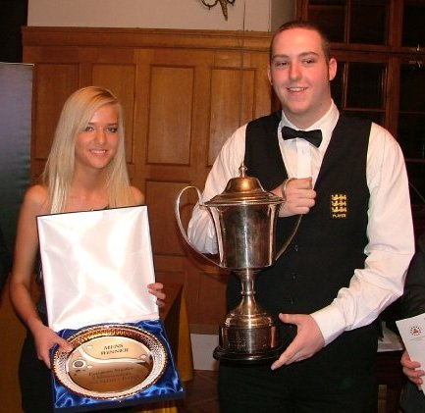
DAVID GRACE
DOB: 05-05-85
Lives: Leeds
Practise Base: Northern Snooker Centre, Leeds
2005 English Amateur Champion
2008 Pontins Open Champion
2008 English Amateur Champion
2008 European Amateur Champion
2011 Q School Event 1 Qualifier

Slide 3
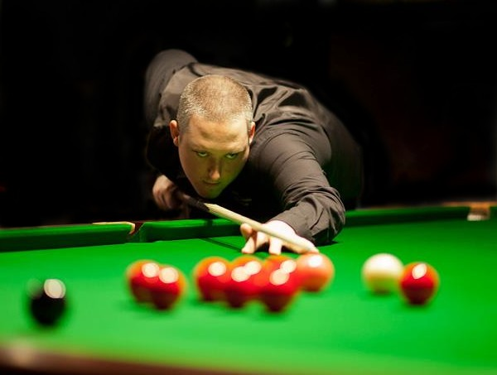
DAVID GRACE
Turned Pro: 2008
2011/12 World Ranking: 80
Highest Pro Break: 139
Highest Tournament Break: 147 (x2)
Best Ranking Performance: Last 48, 2012 China Open
Best PTC Performance: Last 16, 2011/12 PTC 10 & PTC 12

Slide 4
SNOOKER – THRIVING FAN BASE
100,000 Fans attend snooker events each year.
Over 300 million viewers watch snooker around the World
One of the top 5 most watched sports in the UK, China and Europe!
Over 3,200 hours of professional snooker is broadcast each year around the World.
Over 40,000 videos on YouTube, 30,000 friends on Facebook, and 100,000s of followers on Twitter and Weibou.

Slide 5
WORLD SNOOKER TOUR
The World Snooker Tour encompasses over 31 televised events and a further 21 events covered by broadband streaming through betting sites and worldsnooker.tv.
In 2012/13 Season World Snooker Events will be held in UK, Thailand, China, Brazil, Australia, Poland, Germany, Belgium, Holland and Ireland.
Events include: World Snooker Championship, the Masters, UK Championship, International Championship, China Open, Shanghai Masters, Wuxi Classic, Hainan World Open, Australian Goldfields Open, Welsh Open, German Masters, Premier League Snooker, Championship League Snooker, Six Reds World Championship and the Players Tour Championship.

Slide 6
WORLD WIDE TV COVERAGE
World Snooker events are televised live in over 74 countries world-wide and highlights programming taken to a further 7 countries. World Snooker’s total broadcast footprint reaches 481,250,000 homes world-wide.
Albania Algeria Andorra Armenia Australia Austria Azerbaijan Bahrain Belarus Belgium Bosnia-Herzegovina Bulgaria Chad China Croatia Czech Republic Cyprus Denmark Egypt Estonia Finland France Georgia Germany Greece Hong Kong Hungary Iceland India Indonesia Ireland Israel Italy Jordan
Kazakhstan Kosovo Kuwait Kyrgyzstan Latvia Lebanon Libya Liechtenstein Lithuania Luxembourg Macedonia Malaysia Malta Moldova Monaco Morocco Montenegro Netherlands New Zealand Norway Oman Poland Portugal Qatar Romania Russia San Marino Saudi Arabia Singapore Serbia Slovakia Slovenia Sweden Switzerland Syria Taiwan Tajikistan Thailand Tunisia Turkmenistan Turkey United Kingdom United Arab Emirates Ukraine Uzbekistan Vatican Yemen
Highlights package comprises of 8 x 180 min tournament highlights.

Slide 7
BROADCAST PARTNERS
 |  | BBC | EUROSPORT | SKY TV (UK) | CCTV 5 | GSC (SHANGHAI) | NOW TV (HONG KONG) | BEIJING TV | SHENZHEN TV | GUANGZHOU TV | FOX SPORTS AUSTRALIA | SHOWTIME ARABIA | MEASAT MALAYSIA | KUWAIT TV | SKY NEW ZEALAND | CINEPLEX THAILAND | STAR HUB SINGAPORE | LWS.TV BET&WIN
 | WUXI CLASSIC |  | LIVE |  | LIVE |  | LIVE |  |  |  |  |  |  |  |  |  |  | LIVE
 | SIX REDS CHAMPIONSHIP |  |  |  |  | LIVE | LIVE | LIVE | LIVE | LIVE |  |  |  |  |  | LIVE |  | LIVE
 | AUSTRALIA GOLDFIELDS OPEN |  | LIVE |  |  | LIVE | LIVE | LIVE | LIVE | LIVE | LIVE | H/L | H/L | H/L | H/L | H/L | H/L | LIVE
 | PAUL HUNTER CLASSIC (PTC) |  | LIVE |  |  | LIVE | LIVE | LIVE | LIVE | LIVE |  |  |  |  |  |  |  | LIVE
 | SHANGHAI MASTERS |  | LIVE |  | LIVE | LIVE | LIVE |  |  |  | H/L | H/L | H/L | H/L | H/L | H/L | H/L | LIVE
 | BRAZIL MASTERS |  | LIVE |  |  | LIVE | LIVE | LIVE | LIVE | LIVE |  |  |  |  |  |  |  | LIVE
 | POLAND OPEN (PTC) |  | LIVE |  |  | LIVE | LIVE | LIVE | LIVE | LIVE |  |  |  |  |  |  |  | LIVE
 | BELGIUM OPEN (PTC) |  | LIVE |  |  | LIVE | LIVE | LIVE | LIVE | LIVE |  |  |  |  |  |  |  | LIVE
 | INTERNATIONAL CHAMPIONSHIP |  | LIVE |  | LIVE | LIVE | LIVE | LIVE | LIVE | LIVE |  |  |  |  |  |  |  | LIVE
 | PTC EUROPE |  | LIVE |  |  | LIVE | LIVE | LIVE | LIVE | LIVE |  |  |  |  |  |  |  | LIVE
 | PTC EUROPE |  | LIVE |  |  | LIVE | LIVE | LIVE | LIVE | LIVE |  |  |  |  |  |  |  | LIVE
 | UK CHAMPIONSHIP | LIVE | LIVE |  | LIVE | LIVE | LIVE | LIVE | LIVE | LIVE | H/L | H/L | H/L | H/L | H/L | H/L | H/L | LIVE
 | MUNICH OPEN (PTC) |  | LIVE |  |  | LIVE | LIVE | LIVE | LIVE | LIVE |  |  |  |  |  |  |  | LIVE
 | MASTERS | LIVE | LIVE |  | LIVE | LIVE | LIVE | LIVE | LIVE | LIVE | H/L | H/L | H/L | H/L | H/L | H/L | H/L | LIVE
 | SHOOT OUT |  |  | LIVE |  |  |  |  |  |  | H/L | H/L | H/L | H/L | H/L | H/L | H/L | LIVE
 | GERMAN MASTERS |  | LIVE |  |  | LIVE | LIVE | LIVE | LIVE | LIVE | H/L | H/L | H/L | H/L | H/L | H/L | H/L | LIVE
 | WELSH OPEN | LIVE | LIVE |  | LIVE | LIVE | LIVE | LIVE | LIVE | LIVE | H/L | H/L | H/L | H/L | H/L | H/L | H/L | LIVE
 | HAINAN WORLD OPEN |  | LIVE |  | LIVE | LIVE | LIVE |  |  |  | H/L | H/L | H/L | H/L | H/L | H/L | H/L | LIVE
 | PTC GRAND FINAL |  | LIVE |  |  | LIVE | LIVE | LIVE | LIVE | LIVE | H/L | H/L | H/L | H/L | H/L | H/L | H/L | LIVE
 | CHINA OPEN |  | LIVE |  | LIVE | LIVE | LIVE |  |  |  | H/L | H/L | H/L | H/L | H/L | H/L | H/L | LIVE
 | WORLD CHAMPIONSHIP | LIVE | LIVE |  | LIVE | LIVE | LIVE | LIVE | LIVE | LIVE | H/L | H/L | H/L | H/L | H/L | H/L | H/L | LIVE
 | PREMIER LEAGUE |  |  | LIVE | H/L |  | H/L |  |  |  | H/L | H/L | H/L |  |  |  | H/L | LIVE
 | CHAMPIONSHIP LEAGUE |  |  |  |  |  |  |  |  |  |  |  |  |  |  |  |  | LIVE

Slide 8
BROADCAST HOURS WORLD SNOOKER RANKING EVENTS
HOURS
All figures 2011

Slide 9
AUDIENCE REACH WORLD SNOOKER RANKING EVENTS
All figures 2011
+1 min reach

Slide 10
BROADCAST HOURS WORLD SNOOKER INVITATION EVENTS
HOURS
All figures 2011

Slide 11
AUDIENCE REACH WORLD SNOOKER INVITATION EVENTS
All figures 2011
+1 min reach

Slide 12
BROADCAST HOURS PRO TOUR CHAMPIONSHIP
HOURS
All figures 2011

Slide 13
AUDIENCE REACH PRO TOUR CHAMPIONSHIP
All figures 2011
+1 min reach

Slide 14
SPONSORSHIP BENEFITS
Branded Logo Patch on Waistcoat
Worldwide Exposure on Live World Snooker TV
Potential TV Appearances seen by millions
Tickets to events with players room access
Personal endorsements
Corporate Day or Exhibition Night for your company

Slide 15
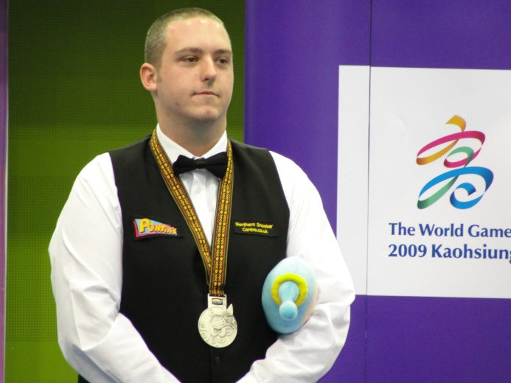
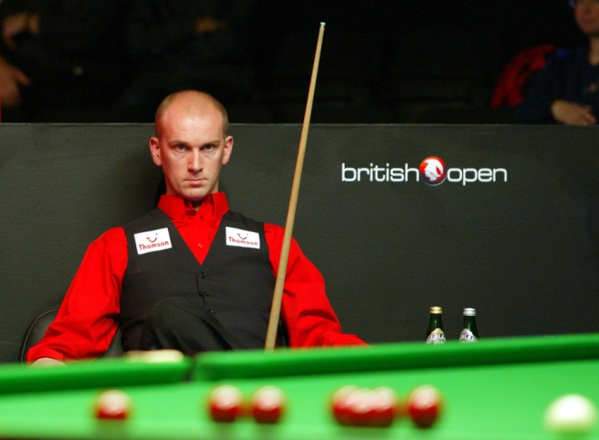
GREAT EXPOSURE FOR YOUR BUSINESS

Slide 16
CONTACT DAVID
E-Mail: daveg147@hotmail.co.uk
Web: www.davidgracesnooker.co.uk

